Slide 1
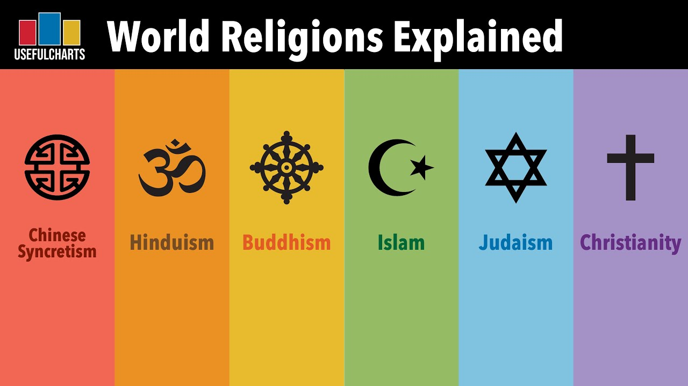
Lecture 2:
Introduction to Popular Religions
Instructor: Ali Raza Abbass
MBA (UK), PGD. Strategic Management & Leadership (UK), BBA (Pak)
Certified Digital Marketer (META, Google, DMI UK)
Master Trainer

Slide 2
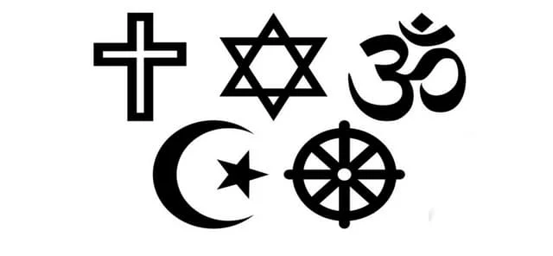
World’s prominent religions
Hinduism
Budhism
Judaism
Christianity
Islam

Slide 3

Hinduism
Hinduism centers on Brahman, the single, all-pervasive Supreme Reality, with individual souls (atma) being a part of it. Core beliefs include the immortal soul, eternal truth, divine scripture (the Vedas), and the cycle of reincarnation (samsara) determined by karma (actions and their consequences). The ultimate goal is moksha, liberation from this cycle and the merging of the soul with Brahman, achieved by living a life of dharma (righteous duty) and pursuing the four aims of life: dharma, artha (prosperity), kama (pleasure), and moksha.

Slide 4
Hinduism
Developed over a span of some 4,000 years
(Polytheism)
Books : 4 Vedas (Rag ved – Uttar ved – Sam ved – Yajar ved) Gita, Maha Bharat, Ramayan
Four stages of life:
1- Getting Education 2- Family Life
3- Dedication to Worship 4- Shunning up of the worldly affairs
Great stress is given on religious affairs
The caste system (1) Brahmins (2) Shatriyas
(3) Vaishyas (4) Sudras
Works: 1- worship 2- protecting the country
3- trade and commerce 4- to serve the other three castes

Slide 5
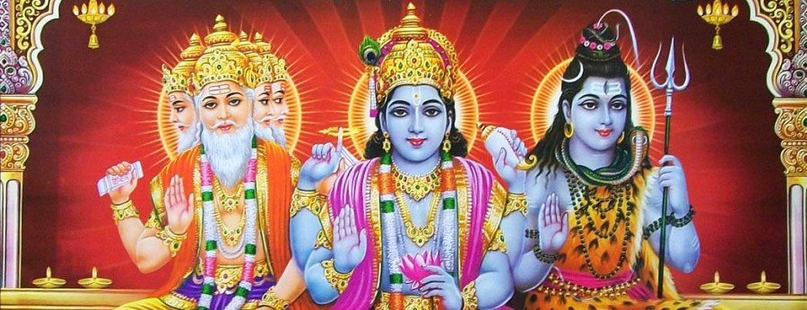
Hinduism (cont.)
Supreme Deities (Brahma, Vishnu and Shiva)
Idol worship
Reincarnation
Dewali
Holi
Dosehra
Satti

Slide 6

Budhism
Buddhism is an ancient Indian religion and philosophy that originated over 2,500 years ago, founded by Siddhartha Gautama, known as the Buddha ("Awakened One"). It centers on the teachings of the Buddha, which focus on suffering, its causes, and the path to enlightenment (nirvana) through morality, meditation, and wisdom. Key principles include the Four Noble Truths and the Noble Eightfold Path, which guide followers toward inner peace and freedom from the cycle of reincarnation.

Slide 7
Budhism
Buddhism was founded in India about 2,500 years ago
Chieftain was Gotama Buddha
The main tenets of the Buddhist belief system include
NEMMK (Nonviolence, Ethical behavior, Moral purity, Meditation, Karma)
Pain--------Desire-------Giving up-------Simple life
Great stress is on religious obligations that worldly affairs are to be completely avoided
No system to earn their livelihood
Buddha never denied the existence of God, but he said that there was no need of supernatural power
Every man could win his inner self (spiritual character) by worshipping and salvation
Right speech, action, livelihood, effort, mindfulness, concentration, thought, and understanding

Slide 8

Judaism (Monotheism)
Judaism is the oldest Abrahamic, monotheistic religion, serving as the foundation of Jewish spiritual, cultural, and legal traditions, centered on the belief in one God and a covenant with the Jewish people. Its central sacred text is the Torah (the first five books of the Hebrew Bible), which contains God's laws revealed to Moses and forms the basis for Jewish life and practices. Judaism is both a religion and an ethnic identity, with an estimated 15 million followers worldwide.

Slide 9
Judaism (Monotheism)
Followers of the Prophet Musa
Descendants of tribe Israel (God’s man)
Holy Book: Tanakh (Taurat)/ Old testament(1- Law, 2- Prophets, 3- Writings)
Talmud(explanation of Tanakh includes the Mishnah – a code of Jewish law)
Worships: Prayers
Jesus was crucified for his claim to be divine
The Jews say that they have a very personal relation with God and the are the best people of God.
The principles of Jewism are also very rigid
The concept of forgiveness has no place in it

Slide 10

Christianity (Polytheism)
Followers of the Prophet Christ (2.2 Billion)
World’s biggest religion
Three main groups: Orthodox, Protestant, Roman Catholic
Holy Book : The Bible 74 Books (New Testament 27 Books+ Old Testament 47 Books)
Old Testament: Books before Christ ( Zabur – Taurat – Sahaif )
New Testament: Books after Christ ( 4 Gospels – Mathew – Loquats – Marques – Johanna )
Worships: Prayers
Christianity considers the Prophet Christ as a son of God as he did not marry
Great stress is on spiritual worship

Slide 11

Islam (Monotheism)
1.8 Billions Followers, The most growing religion
Islam covers each and every aspect of life as well as the spiritual gains
Economic System-----------Islamic Banking (Shirkat---Mudharbat---Murabaha---Ijarah)
Political System (Khalifa---Attributes---Selecting Criteria)
Islamic Social System
Neither stresses more on spiritualism nor on worldly affairs, keeps a balance in both, which is not found before Islam
It is only Islam which is in its pure form even after passing of fourteen centuries

Slide 12
That’s all for today folks!!

